Slide 1

Accelerated Reader Information

Slide 2
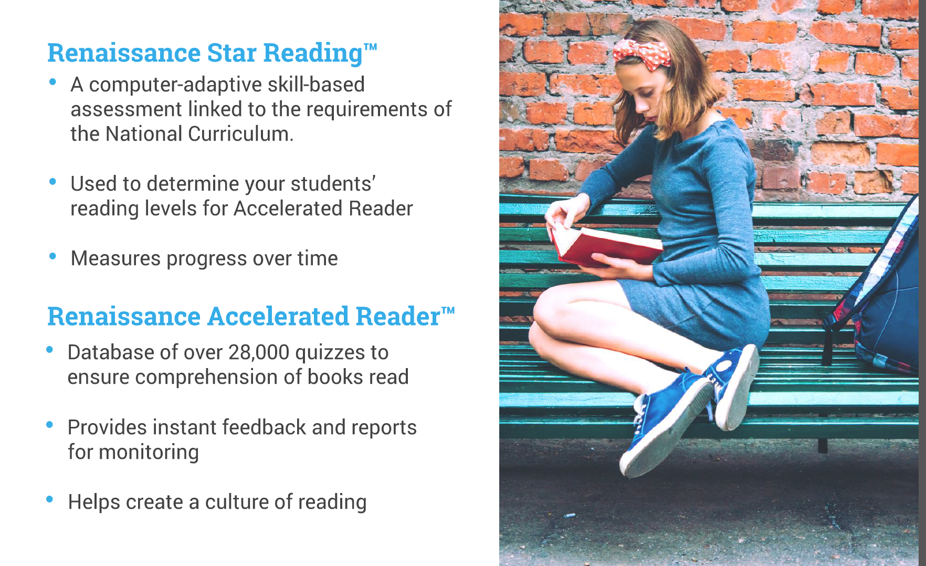
What is AR?

Slide 3
What are some of the benefits of AR?
Pupils are motivated to read and rewarded for doing so.
Pupils are reading at their ability range and progressing through that range at their own pace.
Pupils are given targets and work towards achieving their targets.
Pupils may have the opportunity to take additional vocabulary quizzes meaning they are introduced to new vocabulary.

Slide 4
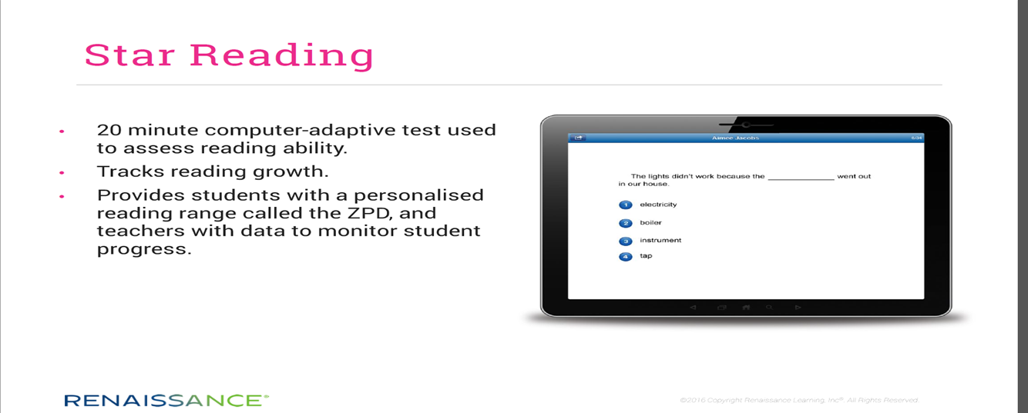
STAR Reading Test
The children will complete a STAR reading test at least four times a year. This provides a reading age and reading range and allows the teacher to track progress throughout the year.

Slide 5
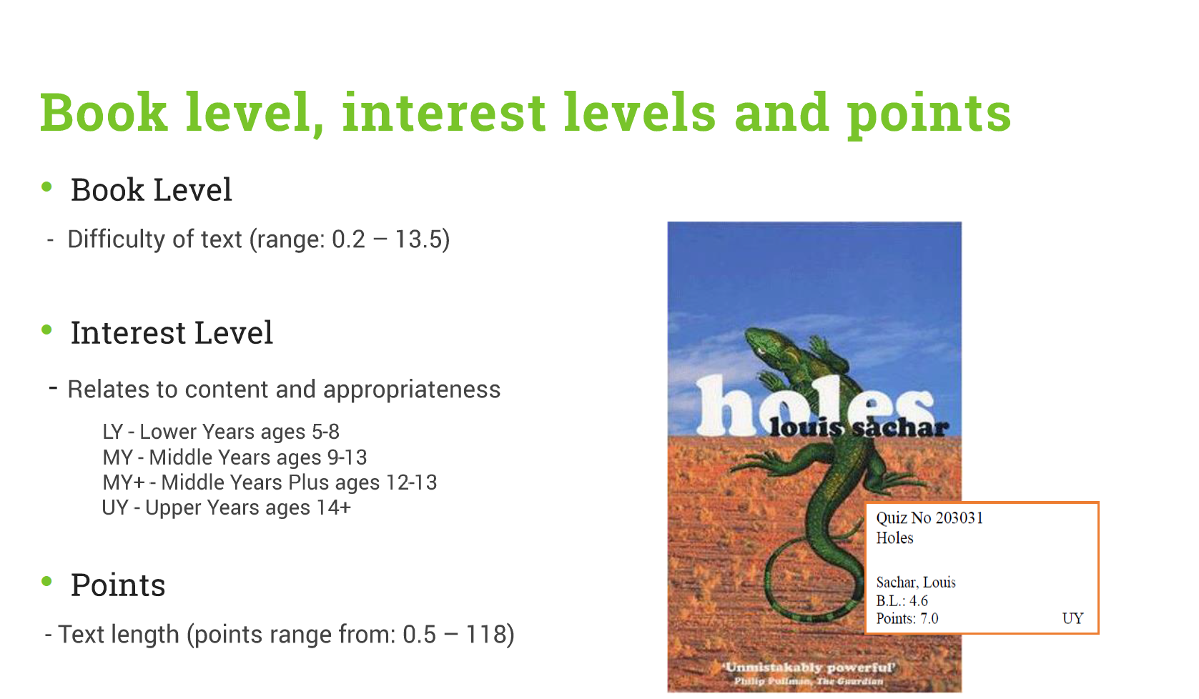
Book Level, Interest Levels and points

Slide 6
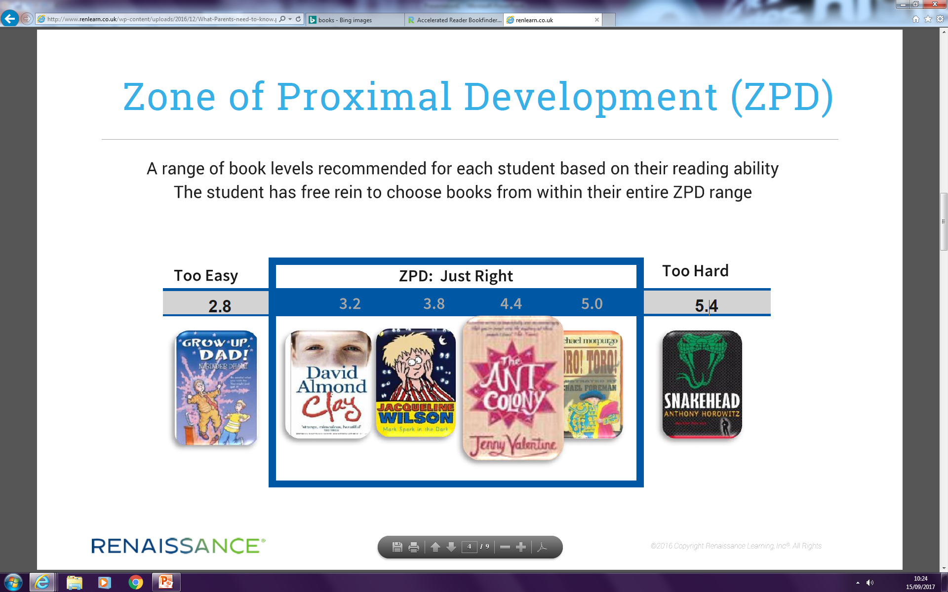
Reading Ranges Explained
Based on their reading age score from the STAR reading test the children will be given a reading range. The child should select books from this reading range. As you move up the reading range, the books become more challenging.

Slide 7
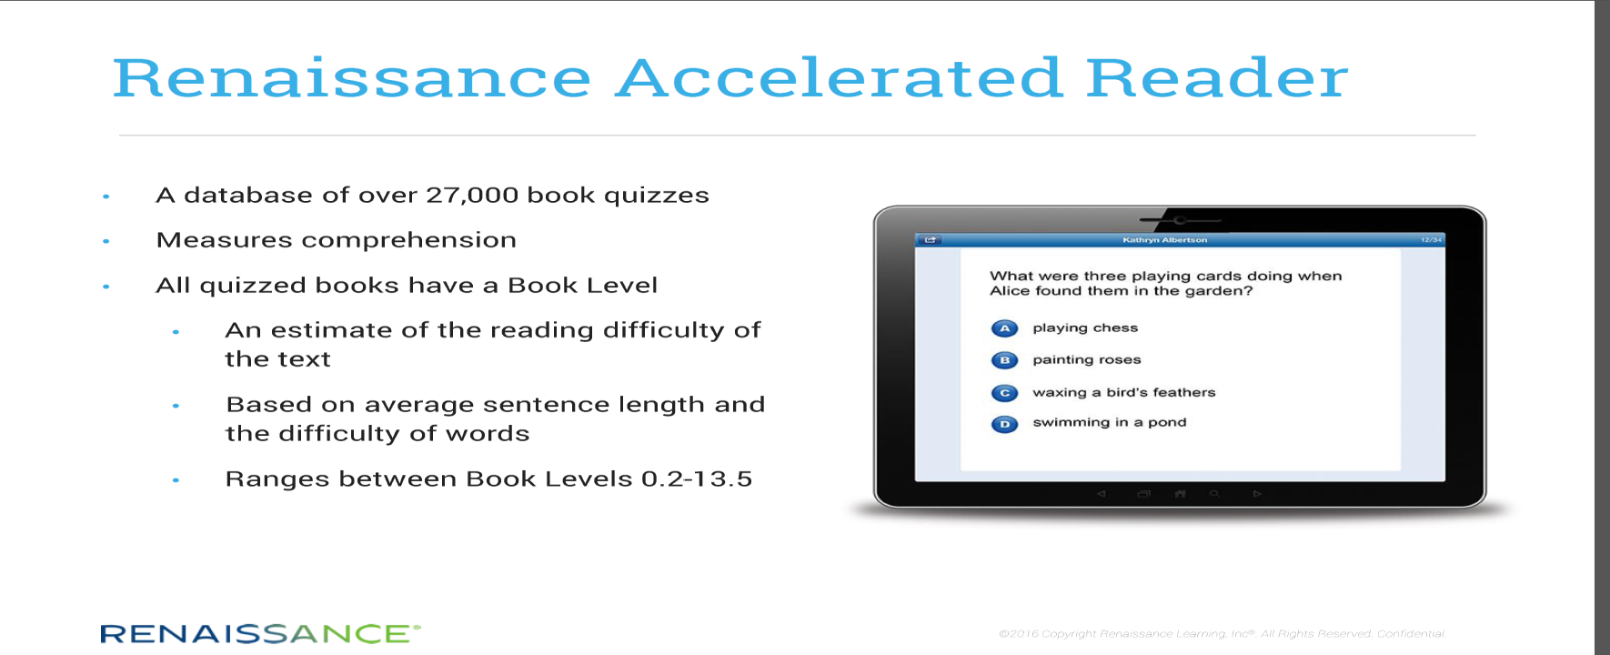
Accelerated Reader Quizzes
Once your child has read their book they take a short reading practice quiz to check their understanding of the book. If they pass the quiz (with a score of 60% or above) they earn points for having read the book. The aim is to reach their points target.

Slide 8
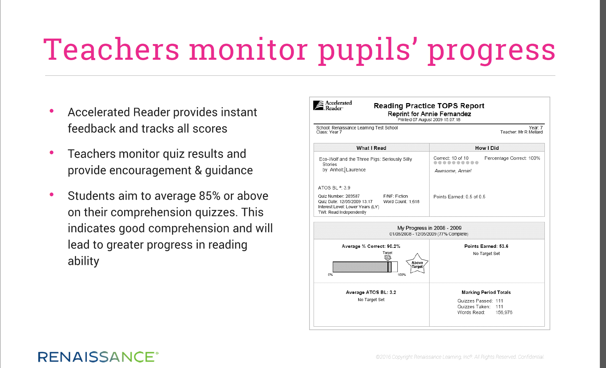
Quiz Feedback

Slide 9
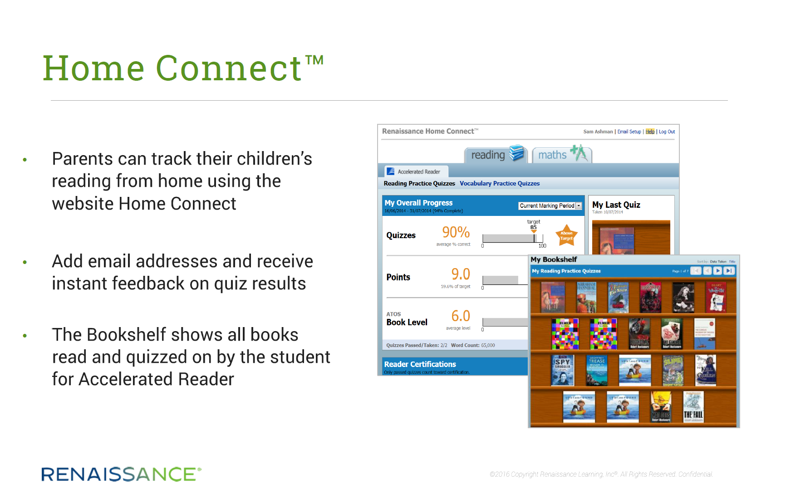
Home Connect

Slide 10
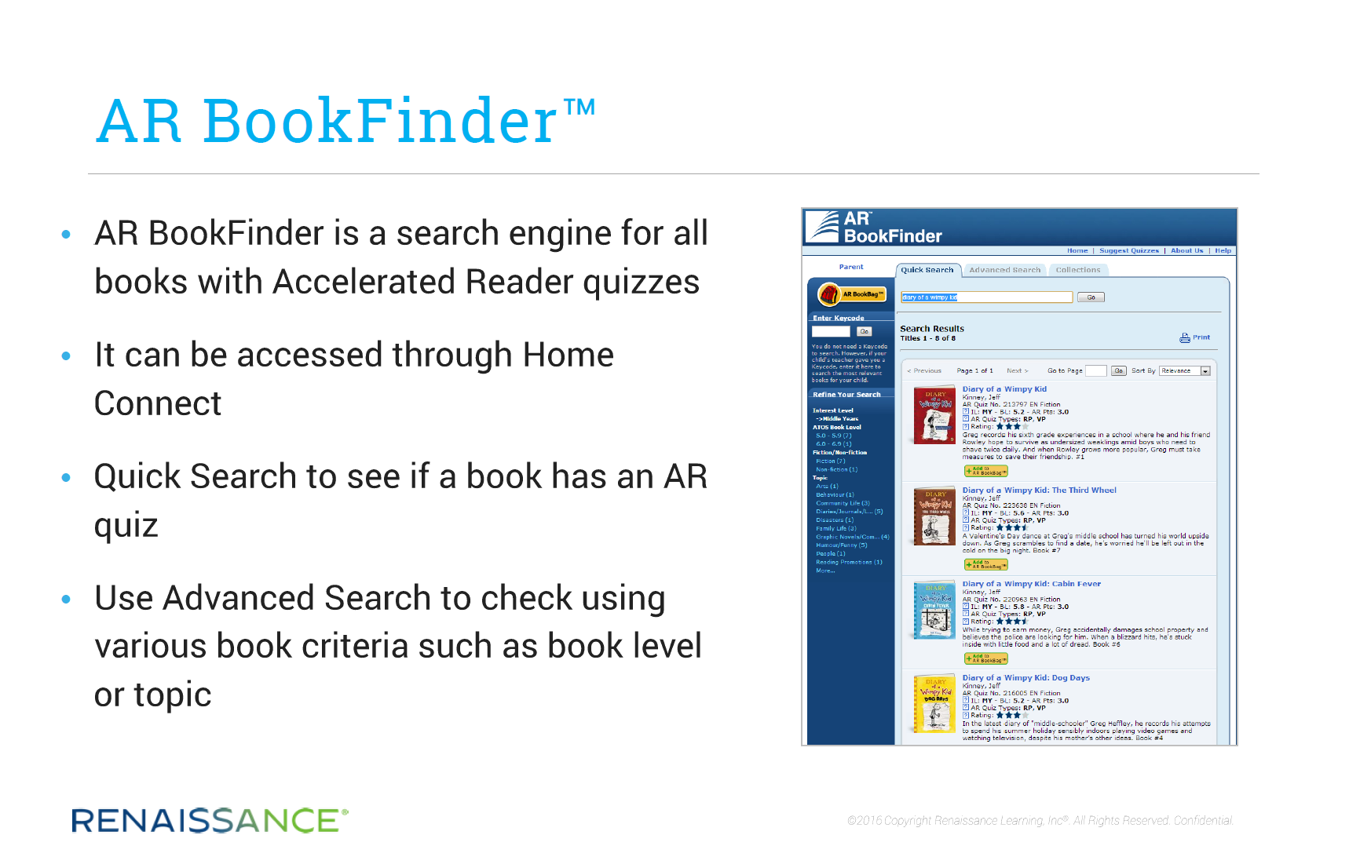
AR BookFinder

Slide 11
What can you do to help?
Ensure your child reads each night for at least 15 minutes. They will have 15 minutes AR time in school.
Encourage your child to read within their reading range- starting at the low end and progressing along.
Encourage the reading of a range of fiction and non-fiction.
Log on to Home Connect to check progress
Find books your child may wish to read by visiting www.arbookfind.co.uk

